Slide 1
Integral Human Pose Regression
Xiao Sun
Joint work with Yichen Wei and Bin Xiao

Slide 2
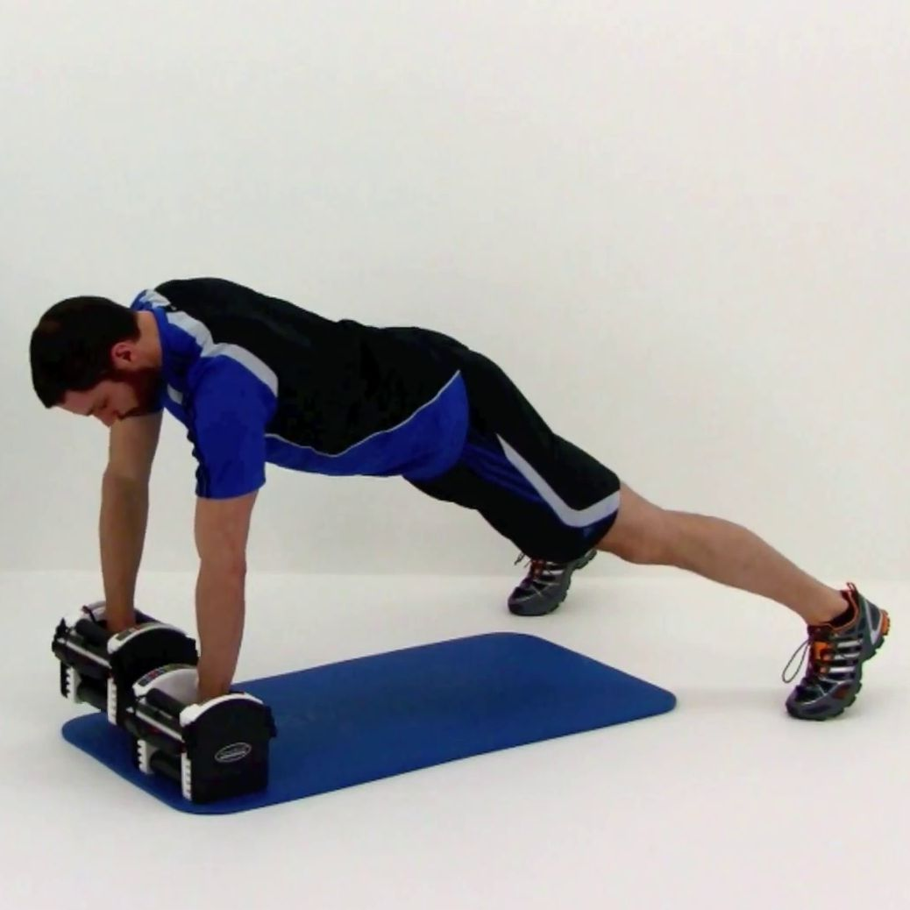
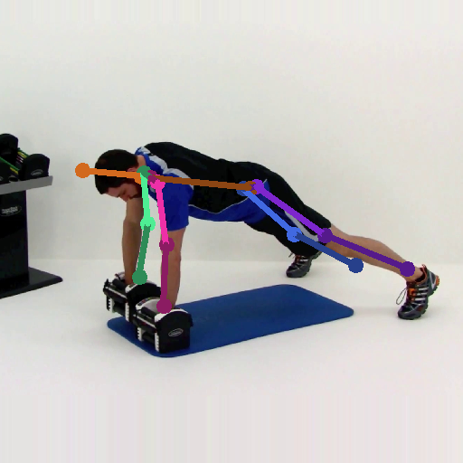
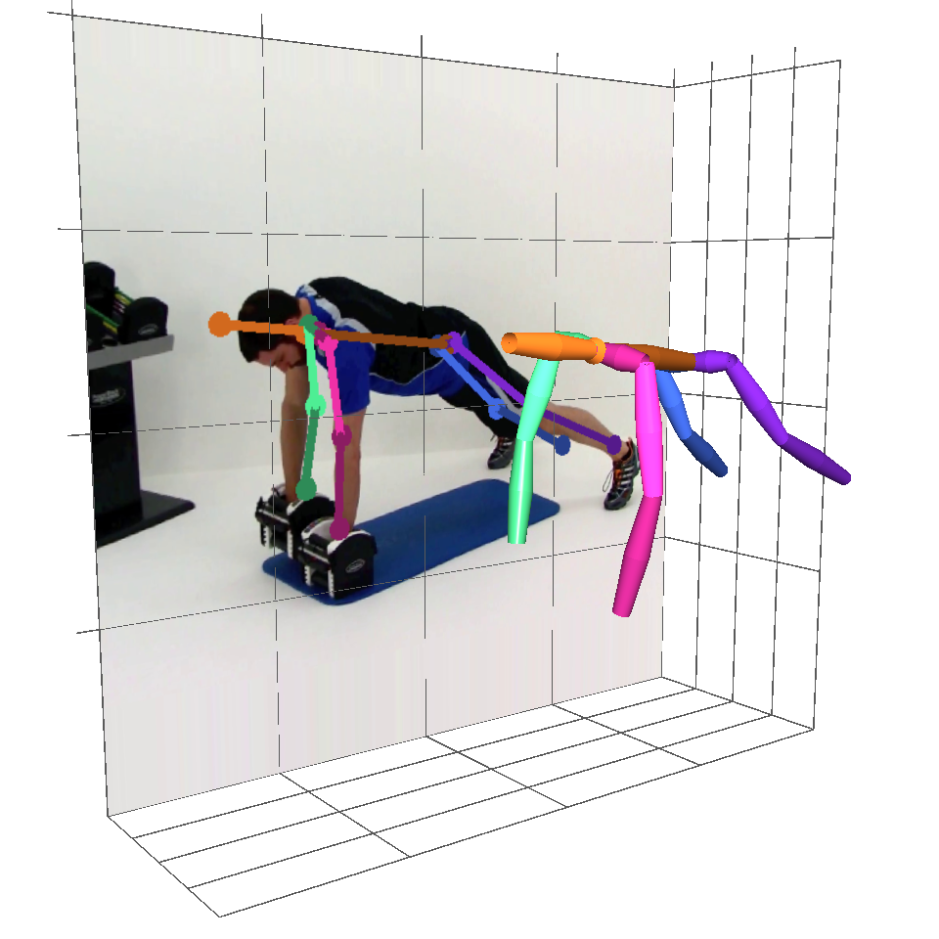
Human Pose Estimation
Problem: localize key points of a person
Input: a single RGB image
Output: 2D or 3D key points
Applications: Motion Sensing Gaming, Augmented or Mixed Reality, etc.
RGB Image (person centered)
Pose Estimator
2D Key Points
3D Key Points
Notes:
The problem of human pose estimation is to localize the key points of a person.
The input is a single RGB image with a person in the image center.
Then a pose estimator is designed to output the location 2D or 3D key points of this person.
Human pose estimation is the underlying key technique for many commercial applications, such as Motion Sensing Gaming, Augmented or Mixed Reality et cetera.

Slide 3
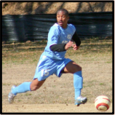
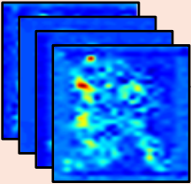
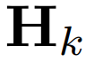
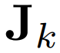
Detection VS. Regression
Detection
Regression
Per-pixel classification
Output: likelihood score maps
Location regression
Output: key points location
: Heatmap
: Joint
Notes:
There are two primary solutions for this problem in the literature. Detection based and regression based. Detection methods classify each pixel into key point classes and output the likelihood score maps, called heat maps, (Specifically, each pixel value in the heatmap represents the probability that a joint exists at this position.). And regression methods just directly regress the location of those key points.

Slide 4
Detection: Post-processing
Detection
Regression
Per-pixel classification
Output: likelihood score maps
Location regression
Output: key points location
: Heatmap
: Joint
Notes:
For detection based method, a per-pixel classification loss, namely a heatmap loss, is designed to train the convolutional neural network using gradient back-propagation. Then, at test phase, a maximum post-process is usually performed on these heatmaps to localize the key points.

Slide 5
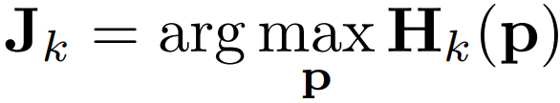
Detection: Post-processing
Detection
Per-pixel classification
Output: likelihood score maps
Heatmap Loss
Post-processing
BP to learn
: Heatmap
: Joint
Notes:
For detection based method, a per-pixel classification loss, namely a heatmap loss, is designed to train the convolutional neural network using gradient back-propagation. Then, at test phase, a maximum post-process is usually performed on these heatmaps to localize the key points.

Slide 6
Detection: Better performance
Detection
Better performance
Per-pixel classification
Output: likelihood score maps
Divide and Conquer: It divides the joint localization task into local image classification tasks. The latter is easier to train, because it effectively reduces the feature and target dimensions for the gradient based learning system.
Heatmap Loss
Post-processing
BP to learn
: Heatmap
: Joint
Notes:
The performance of detection framework is significantly better than regression.
This is because it solves the problem in a “Divide and Conquer” manner. It divides the joint localization task into many local image patch classification tasks. And the latter is easier for CNN to train…

Slide 7
Detection: Drawbacks
Detection
Not-differentiable
Quantization error
Ambiguity
Per-pixel classification
Output: likelihood score maps
Heatmap Loss
Joint Loss
BP to learn
Not a component of learning
: Heatmap
: Joint
Notes:
In spite of its good performance, detection framework still has many drawbacks:
The argmax function is not-differentiable, making it a post-processing step but not a component of learning. The training is not end-to-end. There is a semantic gap between the learning, namely heatmap estimation, and the target, namely joint estimation. This is a fundamental limitation.
The heat map representation leads to quantization error. The heat map resolution is much smaller than the input image resolution due to the down sampling steps in a deep neutral network. The joint localization precision is thus limited by the quantization factor.
Third, a heat map usually present multiple local modes. The ambiguity makes the joint prediction using Eq. (1) unstable and error-prone. This is because heat map learning is essentially a dense per-pixel classification problem. Each pixel is classified independently and it is hard to distinguish locally similar image patches.
In this work, we reformulate this post-processing function to address these problems.

Slide 8
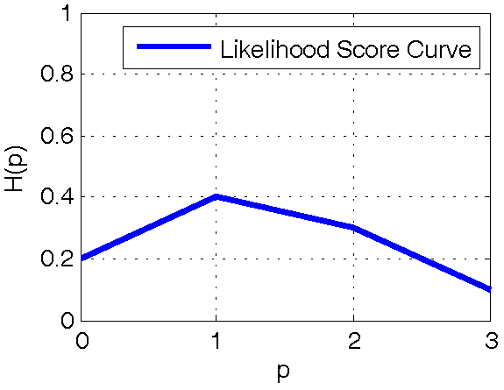


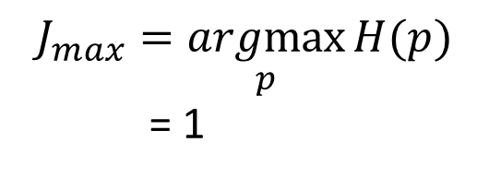
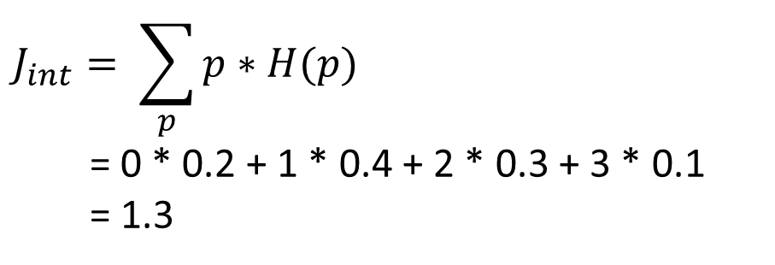
Taking Maximum VS. Taking Expectation
Example: Given the likelihood curve H(p), where is the most probable joint location J?
J?
Argmax
Integration
$$J_{max}$$
$$J_{int}$$
$$J_{int}= \sum_{p}{p∗H(p)}$$
= 0 * 0.2 + 1 * 0.4 + 2 * 0.3 + 3 * 0.1
= 1.3
$$J_{max}=\underset{p}{argmax}{H(p)}$$
= 1
Not-differentiable
Quantization Error
Differentiable
Continuous Output
Notes:
First, let’s consider a much easier one dimensional example. Now, H(p) is a likelihood score curve, for example when p equals to 0, H(p) is 0.2 which means there is 20 percent probability that the joint locates at zero position. So, where is the most probable joint location J? Taking maxmum means directly choose the position with the max probability, that is position 1 in this example. The argmax operation is not-differentiable and has quantization error as we have explained. We propose another solution, taking expectation, to better solve this problem. It is realized by replacing the argmax operation with the integral operation. The final joint location Jint is a summation of all possible positions weighted by their probabilities. Observations at all these positions contribute to the final prediction and yields to single continuous output.

Slide 9
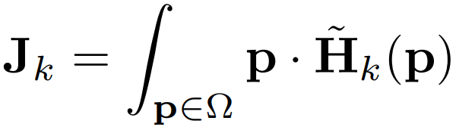

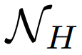
Integral Regression: Taking Expectation
Not-differentiable
Quantization error
Ambiguity
Differentiable
Continuous Output
Single Mode
Heatmap Loss
Joint Loss
BP to learn
Not a component of learning
End to end learning
: Input image
: CNN
: Heatmap
: Joint
Notes:
The proposed integral regression is to replace the argmax operation with the integral operation on the heatmap to generate the joint location. The integral operation is differentiable so that now at training stage, we are able to add joint location supervision to the network for an end-to-end training. It now has continuous output. All local classifiers vote and compromise to a single output. This framework is general and benefits both 2D and 3D human pose estimation tasks.

Slide 10
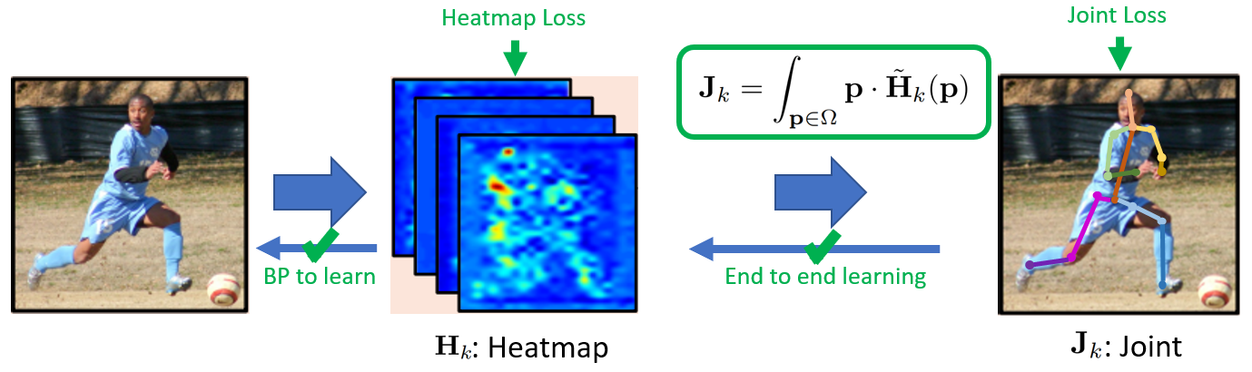
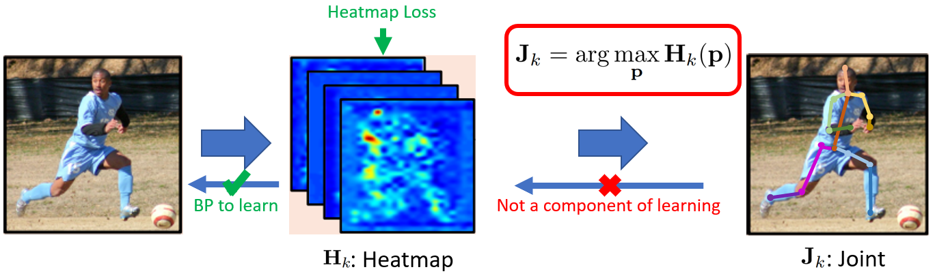
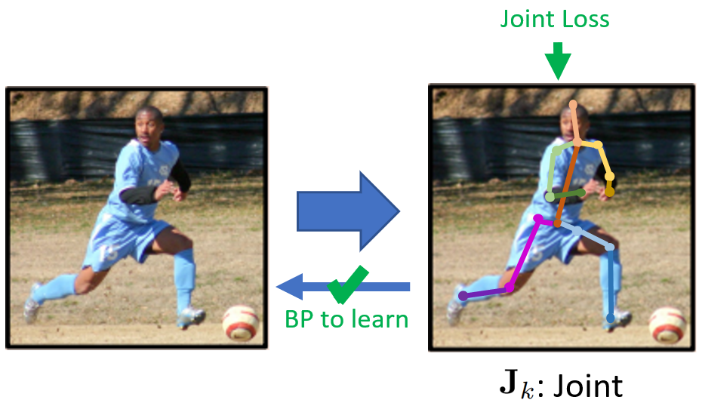
Share the Merits of Both
Integral
Regression
It shares the merits of both heat map representation and joint regression approaches.
Divide and Conquer (Easy to train)
End-to-end learning
Continuous output
Simple, fast, no extra parameters
Compatible with any heat map based methods
Effective (Greatly improve the accuracy)
Detection
Baseline
Regression
Baseline
Notes:
Let’s have an overview of the proposed integral regression, detection and regression baselines. We can see that the integral regression shares the merits of both heatmap representation and joint regression approaches. It has the underlying heatmap representation compared to the regression baseline, it also firstly divides the problem into local image patch classification problems and makes the CNN easy to train. It also has a learnable joint location prediction component compared to detection based methods so that it has end-to-end learning and continuous output. It is simple, fast, introducing no extra parameters. It is compatible with any heatmap based methods. Most importantly, it is very effective that can greatly improve the heatmap based methods. We will give comprehensive experimental proofs in the following experiment part.

Slide 11
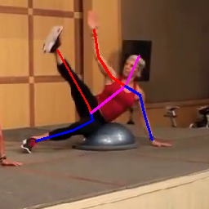
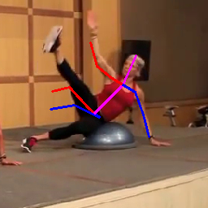
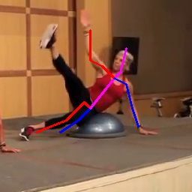
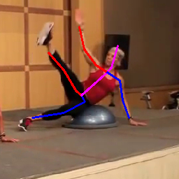
Example Visualization
Ground Truth
Regression Baseline
Detection Baseline
Integral Regression

Slide 12
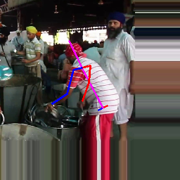
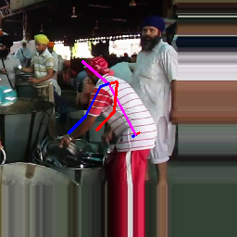
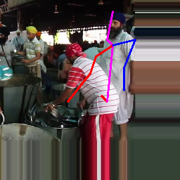

Example Visualization
Ground Truth
Regression Baseline
Detection Baseline
Integral Regression

Slide 13
Methodology for Comprehensive Experiments
Heatmap Loss
Joint Loss
BP to learn
End to end learning
: Input image
: CNN
: Heatmap
Effective under various conditions.
: Joint
5
4
1
2
3
5
1
3
2D or 3D tasks.
Heat map Losses.
Heat map and joint loss combination.
Network architecture.
Image and heat map resolutions.
Notes:
Because the integral regression is parameter free and only transforms the pose representation from a heat map to a joint, it does not affect other algorithm design choices and can be combined with any of them, including different tasks, heat map and joint losses, network architectures, image and heat map resolutions. We conduct comprehensive experiments to investigate the performance of integral regression under all such settings and find consistent improvement. Such results verify that the effectiveness of integral representation.

Slide 14
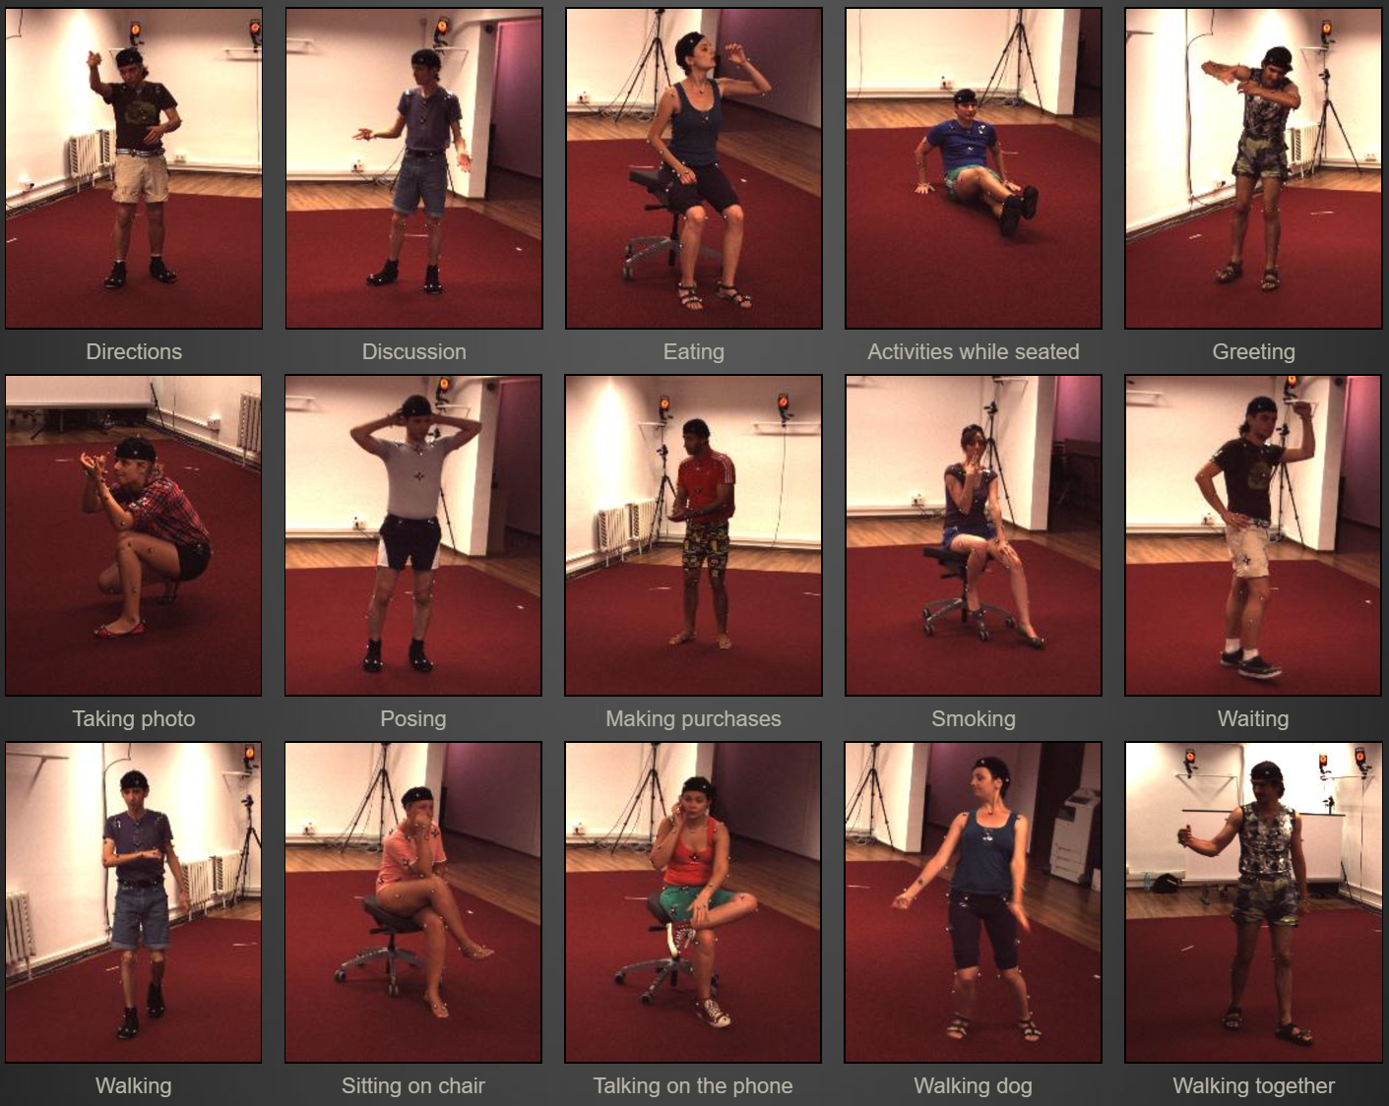
3D Pose Benchmark: Human 3.6M dataset
Lonescu et al., Human3.6m: Large scale datasets and predictive methods for 3d human sensing in natural environments, PAMI 2014
Ground truth by motion capture
7 subjects x 15 actions x 4 cameras
Millions of RGB frames
Notes:
We first evaluate this work on the 3D human pose estimation problem on the Human 3.6M dataset. This dataset is published at 2014. It has 3.6 million images labeled with 3D joint ground truth which is the currently largest 3D pose estimation benchmark. The ground truth is labeled by motion capture sensors. It has 7 subjects, 15 actions and 4 camera views.

Slide 15
Ablation Study: Heatmap and Joint Loss
Network: 50-layer ResNet
Training Dataset:
3D benchmark: Human3.6M
2D benchmark: MPII (for 2D 3D mixed training)
Methods:
It shares the merits of both heatmap representation and joint regression approaches.
[1] Sun et al., Compositional human pose regression, ICCV 2017.
Methods
Notation
Heatmap
Heatmap Loss
Joint Loss
3D Data Only
Mixed 2D 3D Data
[1]
Representation
Regression Baseline
R1
X
X
√
106.6
56.2
Heat Map Baseline
H1
√
√ (One
-
hot)
X
99.5
63.6
H2
√
√ (Gaussian)
X
80.4
59.3
Integral Regression
I*
√
X
√
100.2 (6.0%)
49.6 (11.7%)
I1
√
√ (One
-
hot)
√
86.4 (13.2%)
52.7 (17.1%)
I2
√
√ (Gaussian)
√
66.2 (17.7%)
52.4 (11.6%)
Notes:
Recently, Sun et al. [7] introduce a simple yet effective way to mix 2D and 3D data for 3D human pose estimation and show tremendous improvement. The key is to separate the 2D part (xy) of the joint prediction Jk from the depth part (z) so that the xy part can be supervised by the abundant 2D data. Integral regression can naturally adopt this mixed training technique, thanks to the differentiability of integral operation. We also obtain enormous improvement from this technique in our experiments and this improvement is feasible due to the integral formulation.

Slide 16
Ablation Study: Image & Heatmap Resolution
Image Size
Heatmap Size
Ours
H2 Error
Ours
I2 Error
FLOPs
FLOPs: floating point operations per second.
(
pixel)
(
pixel)
(
mm)
(
mm)
256
64
59.3
52.4
(
11.6
%
)
7.3G
256
32
61.5
61.5
51.7
(
15.9
%
)
6.2G
128
32
66.6
57.1
(
14.3
%
)
1.8G
128
16
86.4
60.9
(75.8%)
60.9
(
29.5
%
)
1.5G
Small image size and heatmap size obtains larger error, but needs less FLOPs.
Integral regression improves accuracy under all cases, especially using small size.
A better choice when computational cost is demanding, in practical scenarios.

Slide 17
Ablation Study: Network Architecture
Network
Architecture
Coarse
-
to
-
Fine.
[3]
Ours
H1
Ours
I1
(Multi
-
stage
HourGlass
[2])
(mm)
(mm)
(mm)
Two-stage
HourGlass
Stage 1
85.8
85.5
78.7 (8.0%)
Stage 2
69.8
68.0
64.1 (5.7%)
Multi-stage HourGlass architecture sets heatmap based state-of-the-art.
Our re-implementation is already slightly better, setting a valid baseline.
Integral Regression improves both stages and sets new state-of-the-art.
[2] Newell et al., Stacked Hourglass Networks for Human Pose Estimation, ECCV 2016.
[3] Georgios et al., Coarse-to-fine volumetric prediction for single-image 3d human pose, CVPR2017.
Notes:
We also want to show that our method is complementary to other important network architecture like the multi-stage Hourglass. Hourglass architecture is first introduced in [2] and almost all leading methods are based on this architecture. Recently it has been applied to 3D pose estimation by [3].
We implement a two stage Hourglass baseline, the performance is slightly better than the original implementation, setting a valid baseline.
Our method improves both stages.

Slide 18
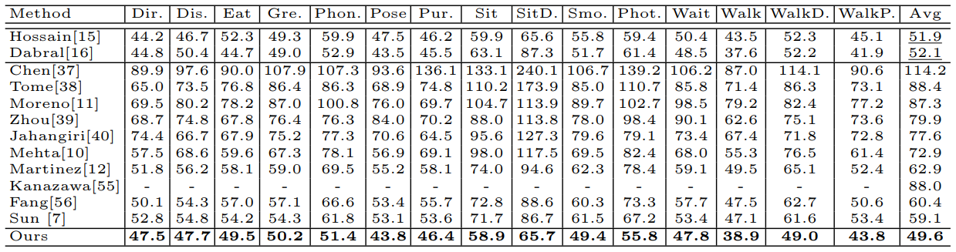
Comparison with the 3D State-of-the-art
Dataset: Human3.6M.
Metrics: mean joint position error in mm. The lower, the better.
Advance the state-of-the-art a large margin, 16.1%.
A record of 49.6mm average joint error.

Slide 19
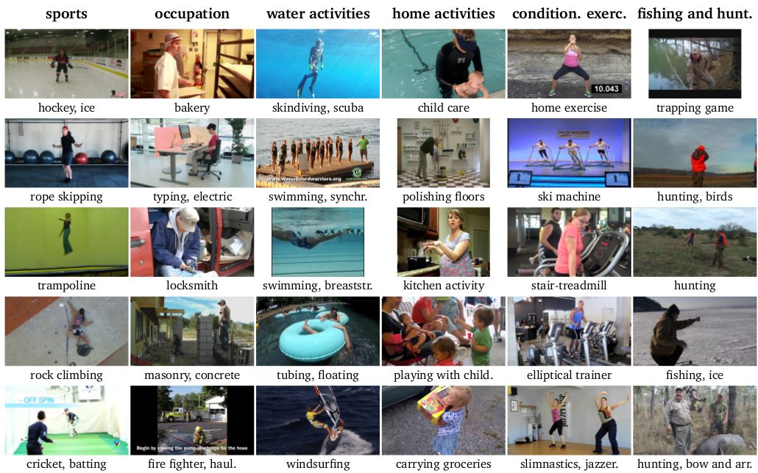
2D Pose Benchmark: MPII dataset
Andriluka et al., 2d human pose estimation: New benchmark and state of the art analysis, CVPR 2014
YouTube videos, 410 daily activities
Complex poses and appearances
25k images, 40k annotated 2D poses
Notes:
We also apply the integral regression on 2D human pose estimation.

Slide 20
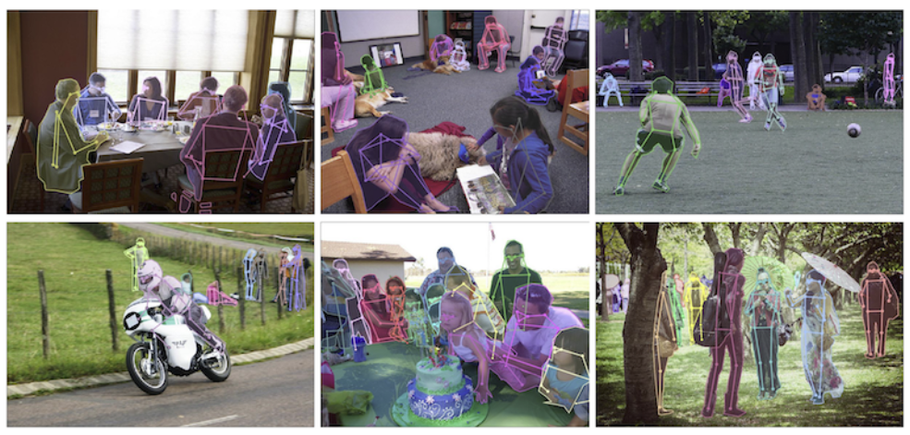
2D Pose Benchmark: COCO dataset
Lin et al., Microsoft coco: Common objects in context, ECCV2014.
Simultaneously detecting people and localizing their keypoints.
Challenging, uncontrolled conditions.
200k images, 250k annotated 2D poses.

Slide 21
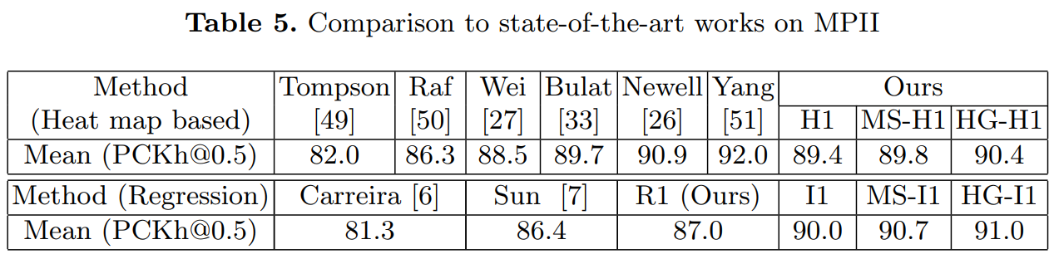
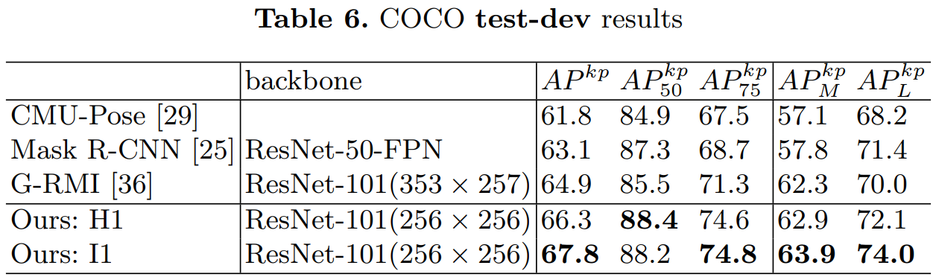
Comparison with the 2D State-of-the-art
Integral regression effectively improves the heatmap accuracy.
Our result achieves/advances the 2D state-of-the-arts.

Slide 22
Conclusions
Integral regression enables end-to-end training for detection-based approach.
It allows for continuous location estimates rather than coarse quantization.
It leads to significant improvement over the state of the art.

Slide 23
Thanks!

